Slide 1
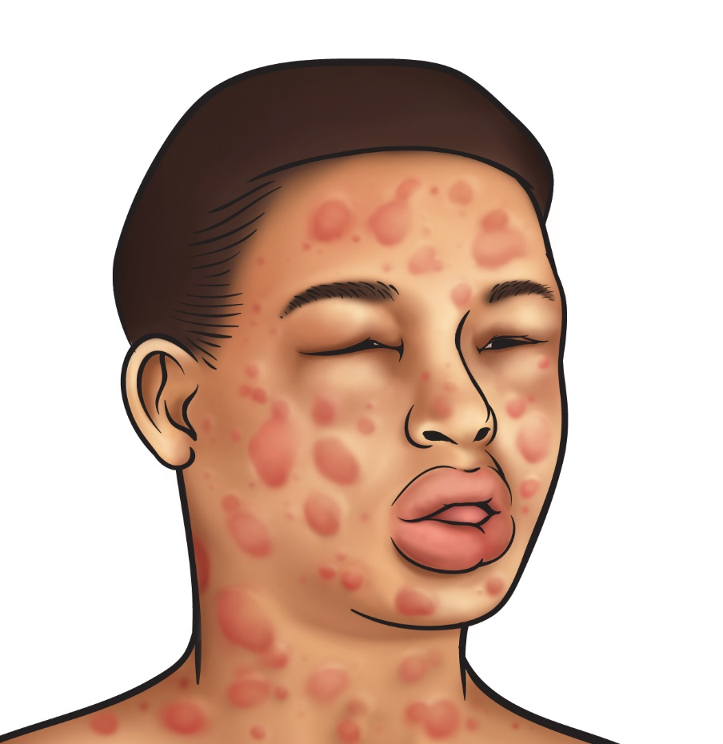
Emergency Management of Anaphylaxis

Slide 2
What is Anaphylaxis?
is a severe, life-threatening, generalised or systemic hypersensitivity reaction

Slide 3
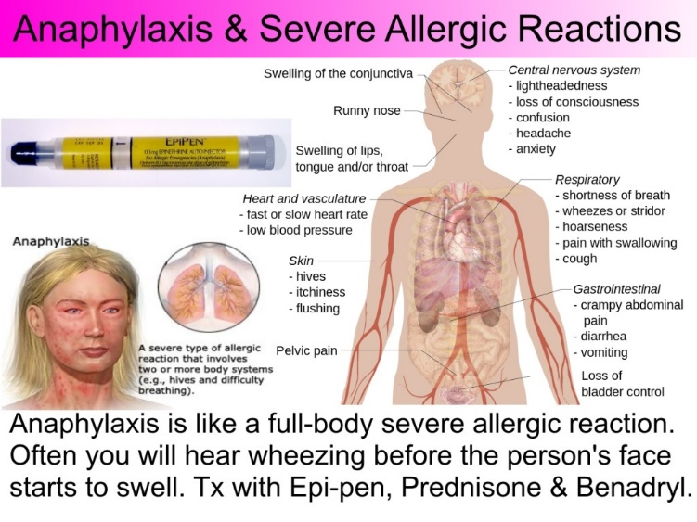
Grand, can you translate that into English???

Slide 4
Anaphylaxis Picture
Is likely when all three of the following criteria are present:
1. Sudden onset and rapid progression of symptoms
2. Life threatening Airway +/- Breathing +/- Circulation problems
3. Skin +/- Mucosal changes such as:
- flushing
- urticaria
- angioedema

Slide 5
The Nuts and Bolts of Managing Anaphylaxis

Slide 6
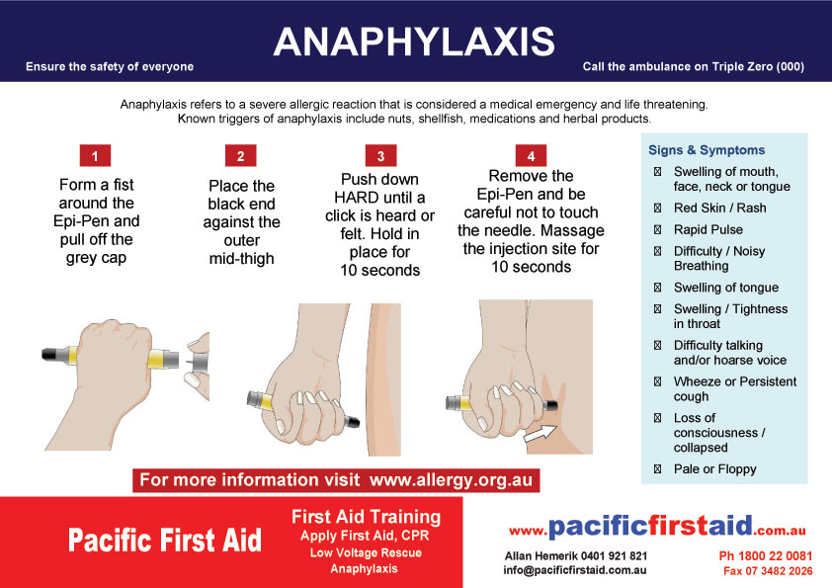
How to Inject Adrenaline IM

Slide 7
Anaphylaxis OSCE

Slide 9
Thank you!

