Slide 1
Oculogyric crisis
Dr. Yewande Olupitan
Senior House Officer: Emergency Medicine

Slide 2
Outline
Background
Definition
Epidemiology
Etiopathogenesis
Clinical Features
Management
Differential Diagnosis
Prognosis
Conclusion

Slide 3
It can be likened to……
Spooky, Sudden & …..

Slide 4
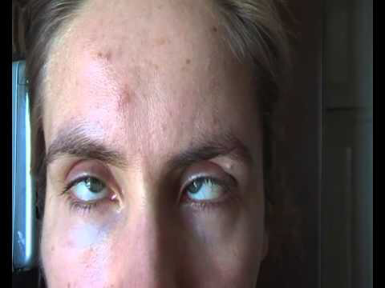

Slide 5
Background & definition
Belongs to the group of Acute Dystonic Reactions.
Often Ideosyncratic & Unpredictable occurrence.
Defined as: An Acute Dystonic reaction of the ocular muscles characterised by bilateral elevation of visual gaze lasting from seconds to hours,

Slide 6
Epidemiology
Under reported reaction
Incidence varies according to individual susceptibility, drug identity, dose & duration of therapy.
In rare instances(as with laryngeal involvement) does it become life-threatening or with resultant long term co- morbidity.
Race,sex & age- related demographics- males, children, teens, young adults.

Slide 7
Etiopathogenesis
Drug-induced alteration of dopamine-cholinergic balance in the nigrostriatum (basal ganglia)
Most drugs produce Dystonic reactions by D2 receptor blockade, which leads to an excess striata like cholinergic output.

Slide 8
Causes
Medication:
Neuroleptics
Metoclopromide
Carbamazepine
Lithium
Levodopa
Amantadine
Chloroquine
Benzodiazepines
Diazoxide
Nifedipine
Tricyclics

Slide 9
Causes
Brain Stem Lesion:
Ischemic
Neoplasticism
Inflammatory
Head Trauma
Infections:
Neurosyphilis
Encephalitis
Others:
Inherited Errors of Metabolism

Slide 10
Clinical features
History:
Most commonly shortly after initiation of drug treatment-50% within 48 hrs, 90% within 5 days of initiation of treatment.
Risk factors include: treatment with potent D2receptor agonist, emotional stress, fatigue, family history of Dystonic, recent cocaine or alcohol use.

Slide 11
Symptoms
Restlessness
Agitation
Malaise
A Fixed Stare
Maximal upward deviation of eyes(Converge,lateral or downward deviation)
Backwards,lateral flexion of the neck
Widely opened mouth
Tongue protrusion
Ocular protrusion

Slide 12
Patient assessment
Safety of Patient & Staff
Vital Signs
History/collateral information
Careful review of medications
Review of medical records
Physical & Neurologic exam ( usually normal)
Mental status exam(usually unaffected).

Slide 13
Treatment
Emergency interventions other than pharmacological treatment rarely required.
Anti cholinergic: Procyclidine, Benztropine
Antihistamine: Diphenhydramine
Consider discontinuing inciting agent & seek specialist opinion
Continue melds PO for 48-72 hrs to prevent relapse
Reassurance
Environmental Maniupulation

Slide 14
Differential diagnosis
Seizure disorder
Delirium
Other Dystonias: Tardive, Parkinsonism, Akathisias..
CNS Lesion(focal basal ganglia or thalamus)
Postencephalitic ParkinsonismTyrosine Hydroxlase Deficiency
*A predictable,rapid resolution of symptoms following Rx confirms diagnosis.
Failure to Improve should prompt clinician to consider alternative diagnosis.

Slide 15
Prognosis
Symptom relief within minutes with Anticholinergics
Recurrent crisis may be observed on medication re-exposure
No long term sequel are are expected once inciting agents are discontinued.

Slide 16
References
Medication-induced Dystonic reactions: JM Kowalski,A Ztarabar et Al
Oculogyric crisis: Canadian Movement Disorder group
Oculogyric crisis: Onuma Kalu MD Web PowerPoint

Slide 17
Thanks for listening!
???

