Slide 2
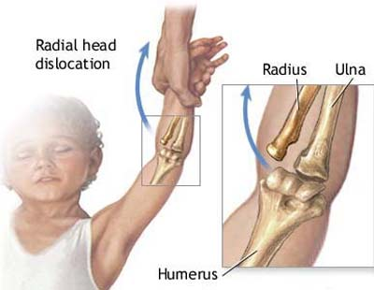

Slide 3
Age
Pulled elbow is common in children between 1-4 years
Rare after the age of 4 years

Slide 4
Mechanism?
Longitudinal axial traction applied to an extended pronated arm
Nursemaid's elbow may happen if you:
Catch a child by the hand to stop a fall.
Lift a child up by the hands or wrists.
Pull a child's arm through a jacket sleeve.
Swing a child by the arms or hands.
Yank on a child's arm to make him or her walk faster.

Slide 5
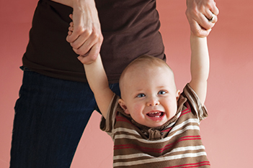

Slide 6
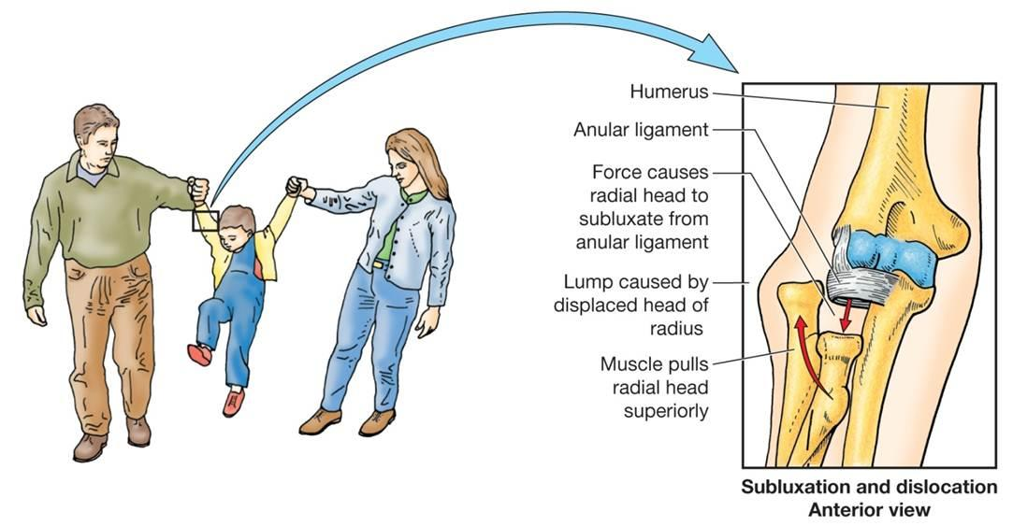
Anatomy

Slide 7
Symptoms and signs
The child will be holding his/her arm in a slightly flexed and pronated position.
refusing to use the arm and supporting it with the other arm.
Erythema, warmth, edema, or signs of trauma are absent.
Pain on moving the arm (especially supination and pronation).
There might be tenderness over the radial head.
Distal circulation, sensation, and motor activity are normal.

Slide 8
Diagnosis
Diagnosis of pulled elbow is mainly a clinical diagnosis.
Imaging modalities are used to exclude possible fractures.

Slide 9
Treatment
Reduction :
1/ Supination
2/ Pronation
Educating parents about recurrence.

Slide 10
