Slide 1
Guidelines review for Asthma & COPD
Dr Fahad
SHO ED

Slide 2
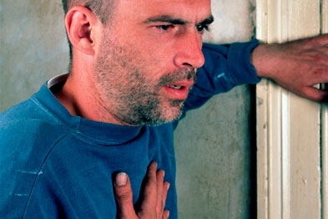
What to do in ER

Slide 5
COPD
Chronic obstructive pulmonary disease (COPD) is a long-term condition that causes inflammation in the lungs, damaged lung tissue and a narrowing of the airways, making breathing difficult.

Slide 6
SYMPTOMS
Breathlessness
Chronic cough, with or without phlegm.
Fatigue, anorexia and weight loss .
Exacerbations can be triggered by infections or exposure to high amounts of air pollution.
Co-morbidities.
IHD, anxiety and depression, osteoporosis, gastro-oesophageal reflux, skeletal muscle dysfunction, anaemia, lung cancer, diabetes and metabolic syndrome.

Slide 7
Examinations
Look for dyspnea,tachypnoea,accessory muscle use , lip pursing & hyperinflated –barrel shaped chest
Listen for coarse crackles.
Cynosis,plethora and RHF

Slide 8
Investigations
Vital Obs
CXR to R/O any Pneumonia,pneumothorax or hyperinflation
ABGs
Baseline labs

Slide 9
Treatment aims
Give Oxygen—maintain SPO2 at 88-92 %
Bronchiodilators--- Nebs with Salbutamol + Ipratropium Bromide
Steriods—Hydrocortisone IV
Repeat ABGs if req
Consider giving IV Salbutamol or Aminophylline if inadequate response to nebs.
Non-invasive Ventilation for exacerbations: CPAP & BiPAP

Slide 10
Sources: www.brit-thoracic.org.uk www.asthmasociety.ie
Thanks

