Slide 1
NON INVASIVE VENTILATION
DR MUHAMMAD BILAL

Slide 2
DEFINITION : - DELIVERY OF MECHANICAL VENTILATION TO THE LUNGS THAT DON’T REQUIRE ET.T. OR TRACHEOSTOMY
IRON LUNG PNEUMOSUIT CHEST
VENTILATION CUIRASS
PNEUMOBELT ROCKING BED PRESSURE VOLUME
ASSISTED ASSISTED
BIPAP CPAP
TYPES OF NIV
NNPV
NPPV
ABDOMINAL DISPLACEMENT

Slide 3
Indications and Contraindications
Indications
-Obstructive sleep apnoea syndrome
Contraindications
-Respiratory arrest or unstable cardiorespiratory status
-Uncooperative patients
-Inability to protect airway
-Trauma or burns involving the face
-Facial oesophageal gastric injury
-Apnoea
-Reduced consciousness
-Air leak syndrome
-Relative contraindications
Extreme anxiety
Morbid obesity
Copious secretions
Need for continuous ventilatory assistance
Diseases with air trapping
-Method of weaning
-Acute lung injury
-Neuromuscular disorder
-Acute congestive heart failure with pulmonary oedema
-Bilateral pneumonia
-COPD with exacerbation

Slide 4
IRON LUNG

Slide 5
NNPV

Slide 6
CHEST CUIRASS

Slide 7
ROCKING BED

Slide 8
PNEUMOBELT

Slide 9
NPPV BIPAP CPAP
Exacerbation of COPD with Respiratory acidosis
Type II respiratory failure with chest wall deformity or neuromuscular disease
Failure of CPAP
Pneumonia with respiratory acidosis
Therapeutic trial with a view to intubation if it fails
Others (ARDS, post-op respiratory failure, to buy time prior to intubation)
Cardiogenic Pulmonary Oedema
Obstructive Sleep Apnoea
Chest Wall Trauma if hypoxic on adequate analgesia
Pneumonia

Slide 10
BIPAP

Slide 11
Patient Selection
Sick but not moribund
Able to protect airway
Conscious and co-operative
Haemodynamically stable
No excessive secretions
Few co-morbidities
Improvement on ABG with NIV

Slide 12
Pressure ventilation vs. volume ventilation
Pressure-cycled modes deliver a fixed pressure at variable volume
Volume-cycled modes deliver a fixed volume at variable pressure
Pressure-cycled modes(P fixed, Vol variable)
Pressure Support Ventilation (PSV)
Pressure Control Ventilation (PCV)
CPAP
BiPAP
Volume-cycled modes (Vol fixed, P variable)
Control
Assist
Assist/Control
Intermittent Mandatory Ventilation (IMV)
Synchronous Intermittent Mandatory Ventilation (SIMV)

Slide 13
INTERFACES
ADVANTAGES DISADVANTAGES
-Easy to implement and remove -Slower correction of gas exchange abnormality
-Improve patient comfort -Gastric distention
-Reduce the need of sedation - Air leaks
-Oral patency, preserve speech, swallowing and cough -eye irritation
-Avoid complication of ETT nosocomial infection injury -Facial skin necrosis
to larynx , hypo pharynx and barotraumas -lack of airway access and claustrophobia
-difficulty in suctioning of secretion and a aspiration of secretions
INTERFACES
NASAL MASK
HELMET
NASAL PILLOWS
FULL FACE MASK

Slide 14
FULL FACE MASK

Slide 15
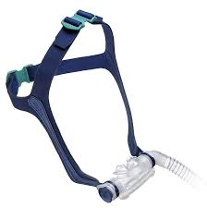
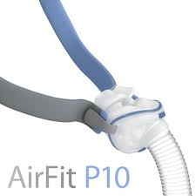
NASAL PILLOWS OR NASAL CUSHIONS
Suitable for patients with
Claustrophobia
Skin sensitivities
Need for visibility

Slide 16
NASAL MASK
Advantages of Nasal Masks
Less risk of aspiration
Enhanced secretion clearance
Less claustrophobia
Easier speech
Less dead space
Disadvantages of Nasal Masks
Mouth leak
Less effectiveness with nasal obstruction
Nasal irritation and rhinorrhea
Mouth dryness

Slide 17
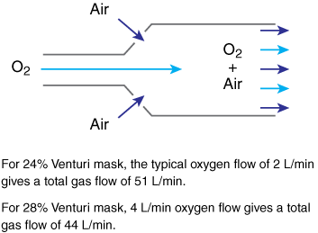
VENTURI MASK

Slide 18
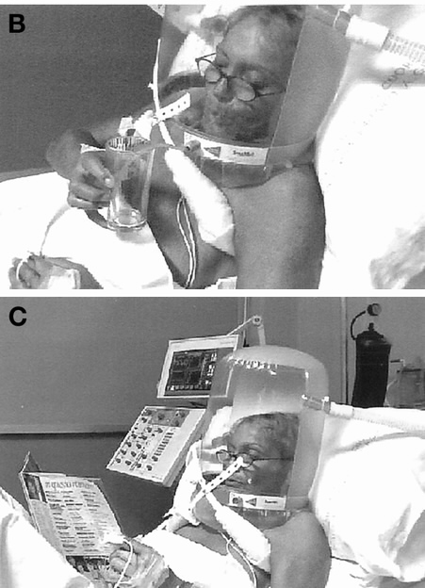
Helmet:-
Allows prolonged continuous application of NIV
Lesser complications like skin necrosis, gastric distension, and eye irritation

Slide 19
High flow oxygen by nasal cannula saves lives over noninvasive ventilation
Noninvasive ventilation’s benefits were shown in hypercarbic respiratory failure, primarily exacerbations of COPD and heart failure. This study suggests that in patients with hypoxemic respiratory failure without hypercarbia (such as due to pneumonia), high-flow oxygen by nasal cannula may be superior, and should be strongly considered as first line treatment instead of NIV.
Frat J-P et al. High-Flow Oxygen through Nasal Cannula in Acute Hypoxemic Respiratory Failure. N Engl J Med 2015; epub May 17, 2015.

Slide 20
THANK YOU

