Slide 1







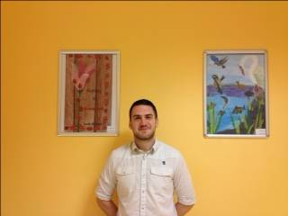

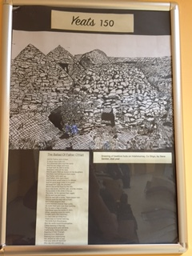

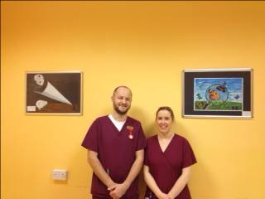

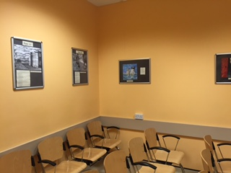




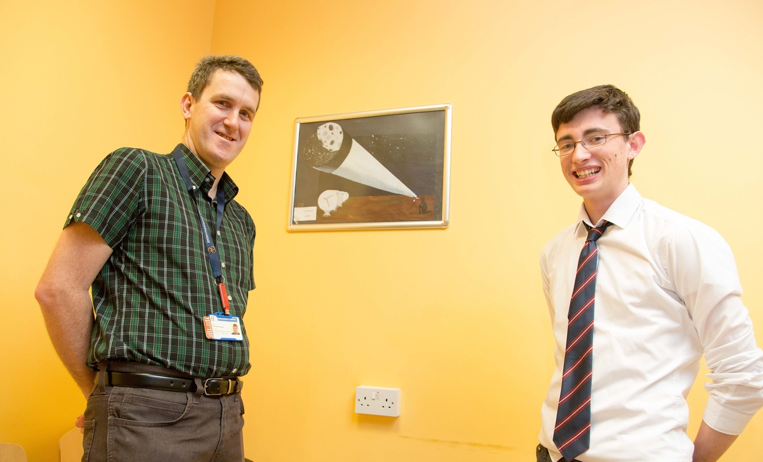




Art in the Waiting Room:
A Quality Improvement Project – The Emergency Department Collaborating with the Local Community
Dr Michael Sweeney, Helen O’Shea, Gemma Rutherford, Emergency Department, Sligo University Hospital, Sligo, Ireland and Máire Hynes, Art Department, Sligo Grammar School, Sligo, Ireland.
Where we are:
The Emergency Department at Sligo University Hospital is situated in the coastal town of Sligo, in the North-West of Ireland. It serves a large geographical area with a population of approx. 250000.
The ED has ~ 35000 adult and paediatric attendances per annum.
What was the issue?
Our newly refurbished waiting room looked bare and cold
ED Waiting Rooms are already stressful environments
What can be done to improve the patient’s experience?
There was no money left in the pot to decorate the Waiting Room
What has been observed in other settings?
Visual Art in clinical waiting areas reduces restlessness, noise level, and number of queries to reception staff
An attractive waiting space has positive correlation with higher levels of perceived quality of care, satisfaction, staff interaction, and reduction of patient anxiety
What did we do?
Purchase wipeable clip-in picture frames
Collaborate with Art teacher in local Secondary School
Students display their artwork in the ED Waiting rooms
Artwork is changed every 6 months for a new exhibition
So, What Happened?
Our ED Waiting Room is freshly decorated every 6 months with a new exhibition
Feedback from patients and their families has been extremely positive
Staff in ED love to see the new exhibits; the art makes for a more pleasant work environment
A great opportunity to collaborate with students in the local school
Local newspapers have run it as a good news story
References:
Nanda U et al. Impact of visual art on patient behavior in the emergency department waiting room. Journal of Emergency Medicine. 2012 ;43(1):172-81.
Beccker F and Douglass S. The Ecology of the Patient Visit: Physical Attractiveness, Waiting Times, and Perceived Quality of Care. Journal of Ambulatory Care Management.2008 ;31(2):128-141.
Biddiss E et al. The effectiveness of interventions aimed at reducing anxiety in health care waiting spaces: a systematic review of randomized and nonrandomized trials. Anesthesia & Analgesia. 2014;119(2):433-48.
ed.admin@hse.ie
www.edsligo.ie
@EMedSligo

